Slide 1
For Live Session Unit 11
Javier Saldana

Slide 2
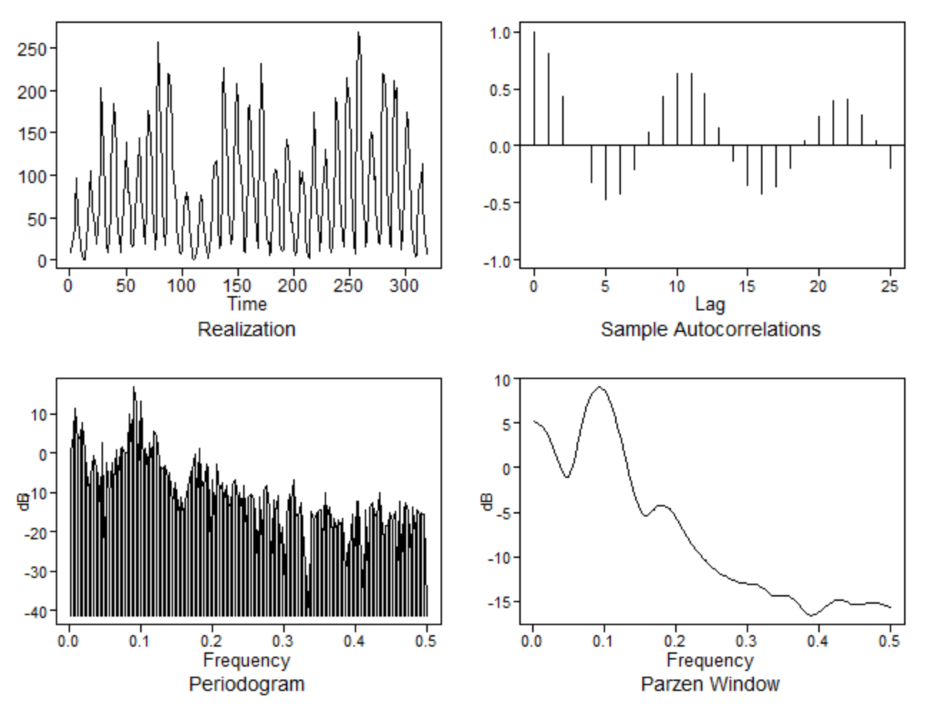
Sunspot Data – Plot Data & Stationarity
plotts.sample.wge(sunspot$V2)
Stationarity
The quickly damping and oscillating behavior displayed in the sample autocorrelations suggest there is evidence of stationarity.

Slide 3
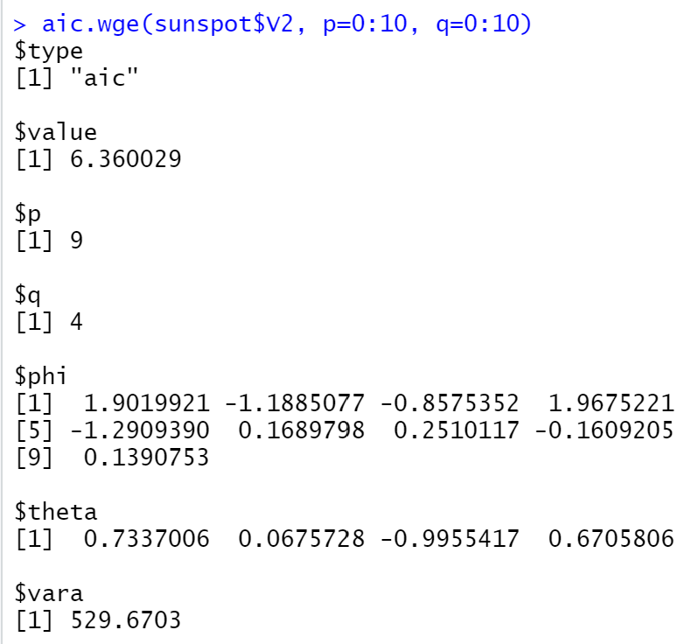
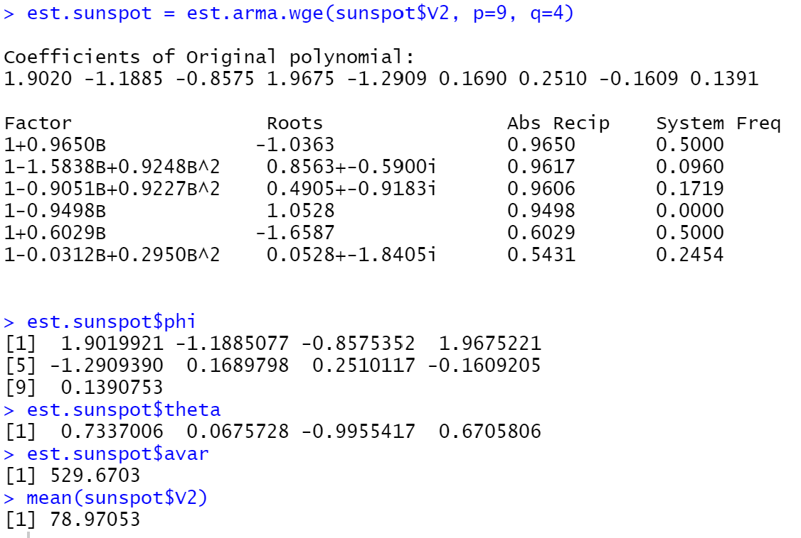
Sunspot Data – Fit the model using your model identification (p and q). You may use any of the estimates you like (maximum likelihood, Yule–Walker, Burg).

Slide 4
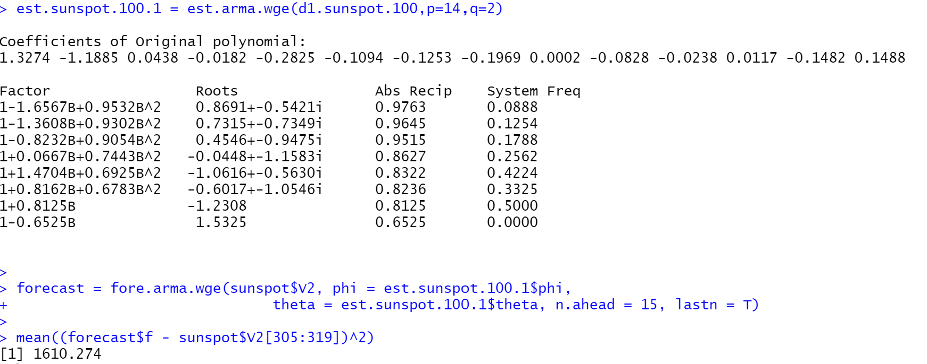
Sunspot Data - Now fit a seasonal model to the Sunspot data (you pick the value of s), and find the ASE for this model using the last 15 years of sunspot data.

Slide 5
Sunspot Data - Describe which model you prefer, and why.
I prefer the seasonal model simply because I am confident solar activity is seasonal and as a result, sunspots are seasonal as well. Considering the span of solar activity is extremely long, the cycles would be very long, which is why I selected 100. It seems that at the 100 mark, the sunspots died down and resurfaced. In addition, the seasonal model has the lowest ASE when compared.

Slide 6
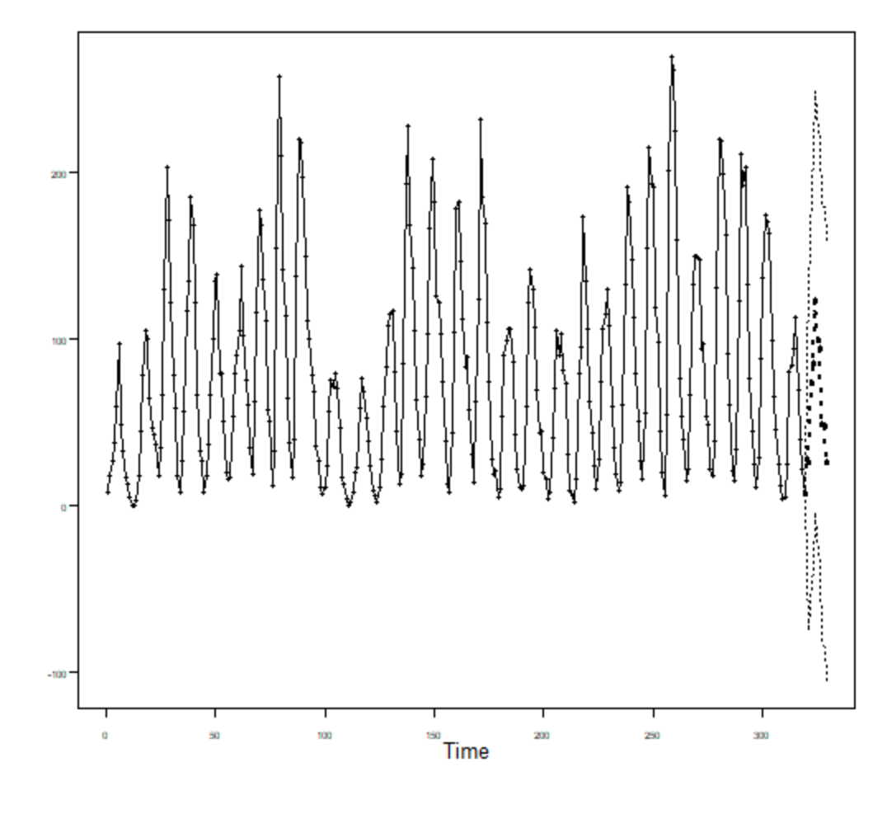
Sunspot Data - Use your best model (the one you choose) to forecast the next 10 years of sunspot data.
forecast.arma = fore.arma.wge(sunspot$V2, phi = est.sunspot$phi,
theta = est.sunspot$theta, n.ahead = 10, lastn = F)

Slide 7
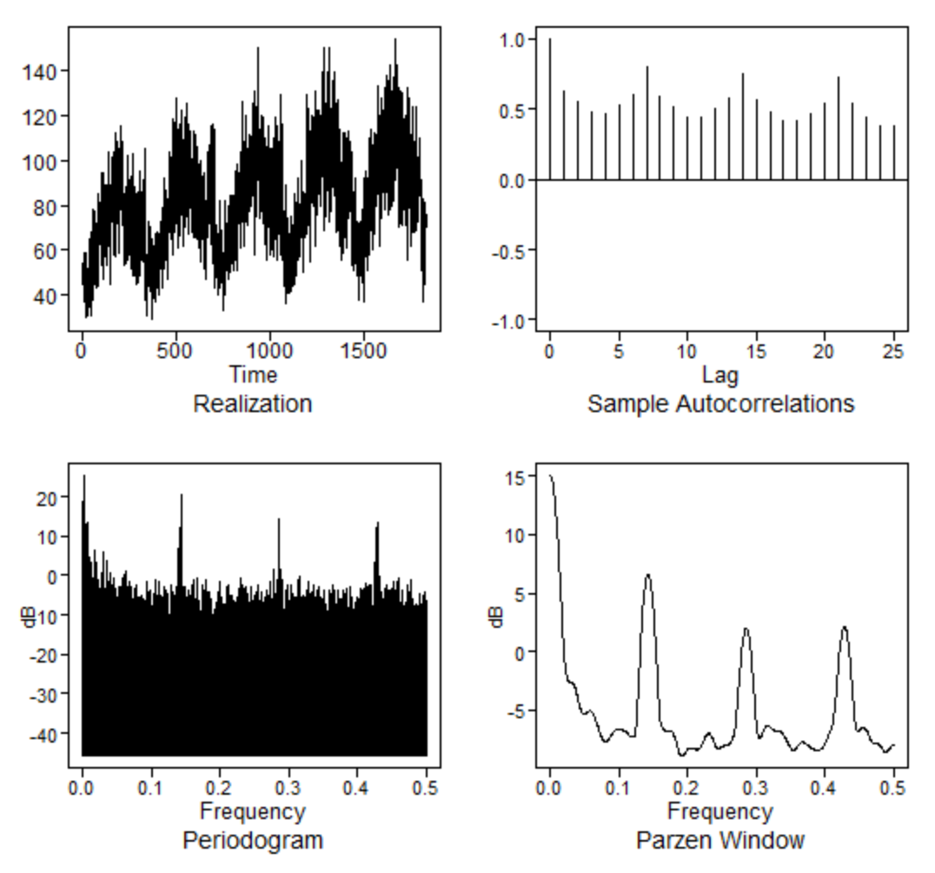
Do your best to develop the best model you can to forecast the next year of Walmart data (store 8 item 50). Create 3-5 slides to fully describe your analysis and please include the ASE with respect to the last 365 days of the realization.
#Walmart Example
Walmart <-read.csv(text = getURL("https://raw.githubusercontent.com/BivinSadler/MSDS-6373-Time-Series/master/Unit%202/Walmart.csv"))
Stor8Item50 = Walmart %>% filter(item == 50 & store == 8)
plotts.sample.wge(Stor8Item50$sales)

Slide 8
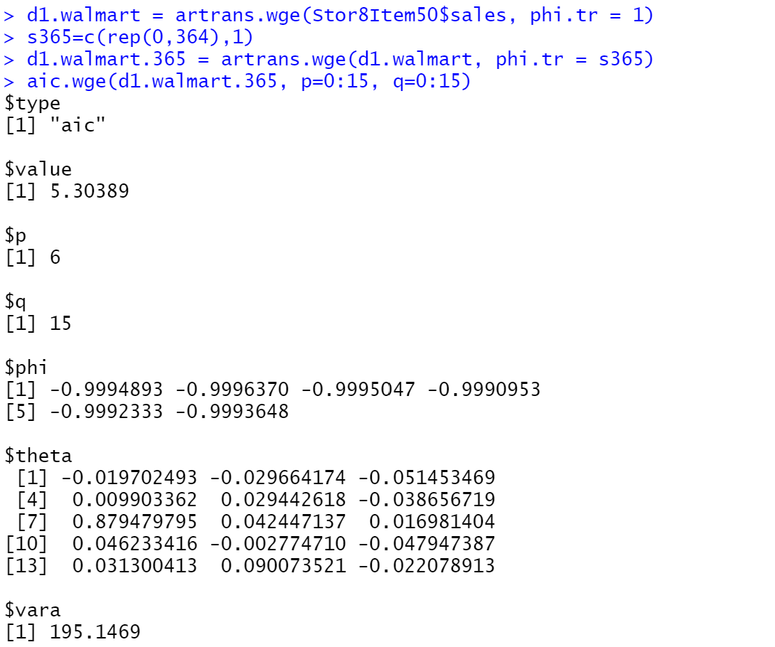
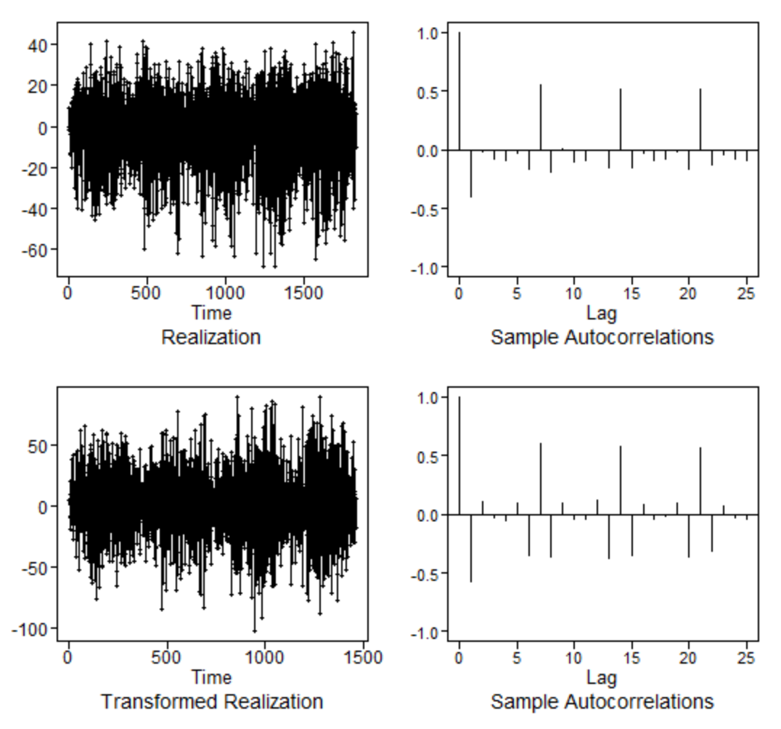
Do your best to develop the best model you can to forecast the next year of Walmart data (store 8 item 50). Create 3-5 slides to fully describe your analysis and please include the ASE with respect to the last 365 days of the realization.

Slide 9
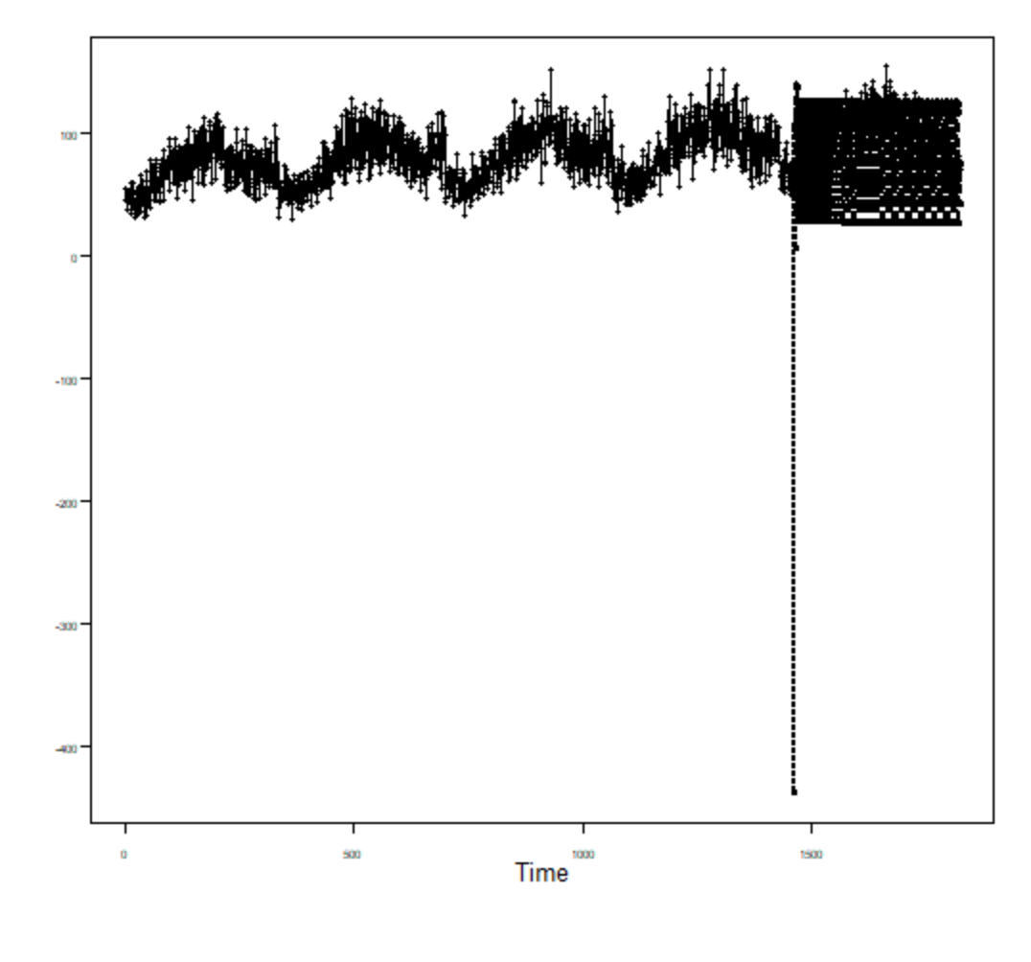
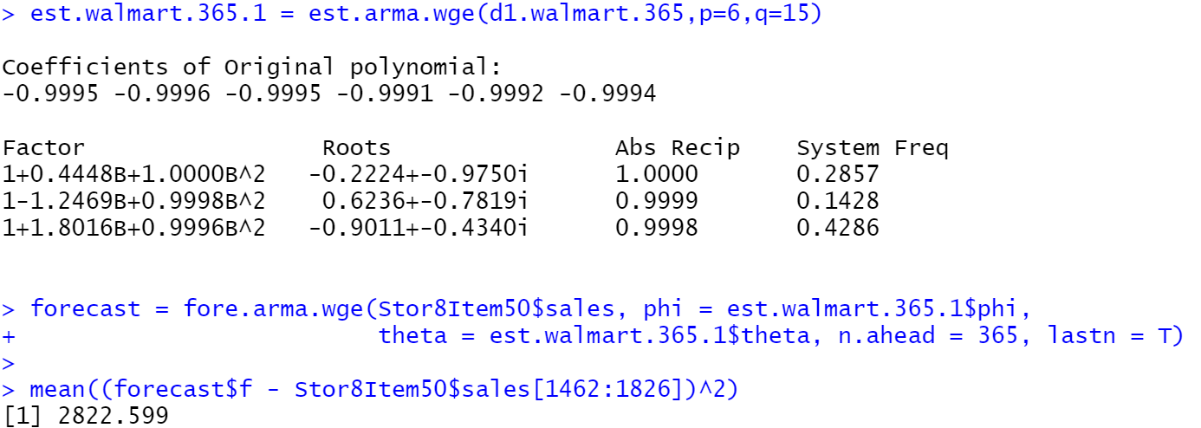
Do your best to develop the best model you can to forecast the next year of Walmart data (store 8 item 50). Create 3-5 slides to fully describe your analysis and please include the ASE with respect to the last 365 days of the realization.

Slide 10
Do your best to develop the best model you can to forecast the next year of Walmart data (store 8 item 50). Create 3-5 slides to fully describe your analysis and please include the ASE with respect to the last 365 days of the realization.
Considering the data is sales, it is to be expected there would be a seasonal element to it. Sure enough, the seasonal trend became apparent in the plot of the data. As a result, we go ahead and remove the trend and seasonality from the data by differencing it twice. Once we do so, we can then begin to look into the AIC since now the data would be rendered stationary. The AIC calculation gives us a recommended ARMA (6,15) to use as our model. We fit the model and then forecast using the given model. We cross reference our forecast with that of the previous 365 days and generate an ASE of 2822.599.

Slide 11
Key Takeaways & Questions
An analyst has full discretion to decide how to model the time series.
Every decision must be supported in order to justify the strength of the model.
Just because the models satisfy the assumptions doesn’t mean it is the best model available. It simply means it is a useful model.

